Slide 1
VOLTAGE CONTROL IN INVERTERS
PULSE WIDTH MODULATED INVERTERS
PWM SCHEMES:
Single Pulse Modulation (SPM)
Symmetrical Multiple Pulse Width Modulation (SMPWM)
Sinusoidal PWM (SPWM)
Selective Harmonic Elimination
Current controlled PWM
Delta modulated PWM
Space Vector PWM (SVPWM)
Third Harmonic Injection PWM

Slide 2
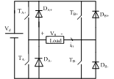
1. Single Pulse Modulation
T_{A+} T_{B-}
T_{B+} T_{A-}

Slide 3
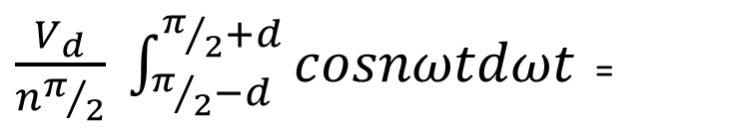
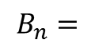
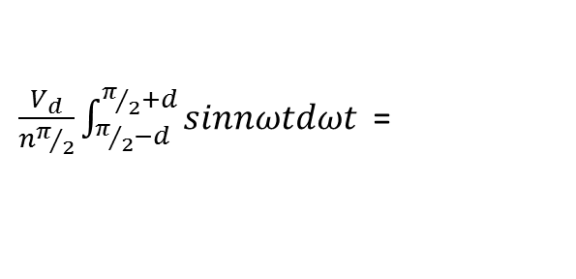
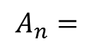
V_{01peak} is maximum when d = π/2
or when pulse width 2d is equal to π or square wave condition.
,
T_{A+} T_{B-}
T_{B+} T_{A-}
$\frac{V_{d}}{nπ/2}\int_{π/2−d}^{π/2+d}{sinnωtdωt}$ =
$$A_{n}=$$
$\frac{V_{d}}{nπ/2} \int_{π/2−d}^{π/2+d}{cosnωtdωt}$ =
$$B_{n}=$$

Slide 4
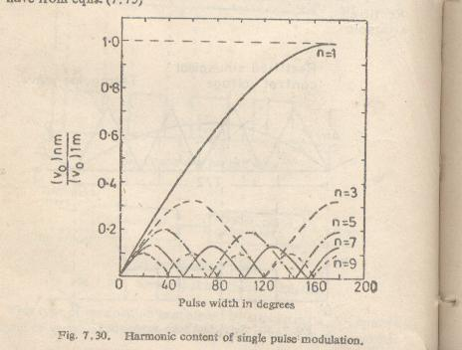

Slide 5
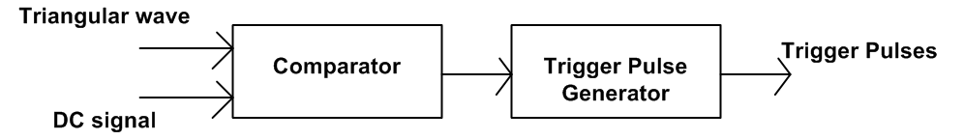
SYMMETRICAL MULTIPLE PULSE WIDTH MODULATION
Several pulses per half cycle are made.
A dc control signal of variable magnitude A is compared with a triangular wave of magnitude A_{m} in a comparator.

Slide 6
Blanking signal

Slide 7
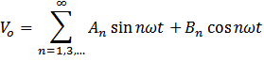
For a pair of pulses positioned at α_{k} and π+ α_{k}
Π+α_{k}
α_{k}
Π
2Π

Slide 9
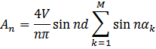
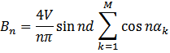
If M such pairs of pulses are present in one cycle, then ;
Π+α_{k}
α_{k}
2Π
Π

Slide 10
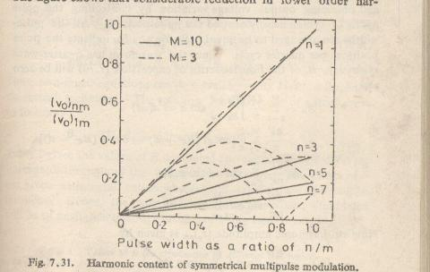

Slide 11
Switching losses are high.
Fast turn on and turn off devices are required

Slide 12
SELECTIVE HARMONIC ELIMINATION (SHE)
Special category of multiple pulse modulation scheme
Elimination of undesirable lower order harmonics and
control of fundamental voltage.
Several symmetrical pulses are made in a cycle
Pulse notches are made at predetermined angles to eliminate certain harmonics.
To eliminate K number of harmonics, (K+1) notches are made in one quarter cycle.

Slide 13
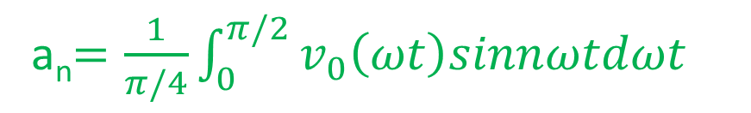
even harmonics are absent. b_{n} =0
a_{n}$=\frac{1}{π/4}\int_{0}^{π/2}{v_{0}\left(ωt\right)sinnωtdωt}$

Slide 15
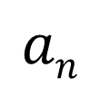
If it is required to
eliminate 3rd, 5th and 9th harmonics
and
control the peak of fundamental component to 50%
of input voltage V_{d}.
k = 3,
k+1 = 4 notches are required for the output voltage in one quarter cycle.
Coefficient of 3rd, 5th and 9th harmonics should be zero.
$$an$$
a₃ = 0
a₉ = 0
a₁ = 0.5V_{d}
a₅ = 0

Slide 16
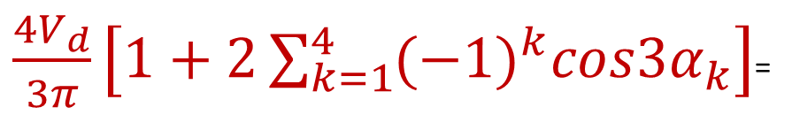
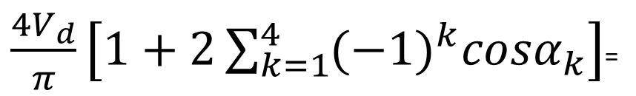
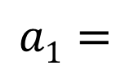
$\frac{4V_{d}}{π}\left[1+2\sum_{k=1}^{4}{{(−1)}^{k}cosα_{k}}\right]$=
$$a1=$$
$\frac{4V_{d}}{3π}\left[1+2\sum_{k=1}^{4}{{(−1)}^{k}cos{3α}_{k}}\right]$=
a₃$=\frac{4V_{d}}{3π}\left[1−2cos3α_{1}+2cos3α_{2}−2cos3α_{3}+2cos3α_{4}\right]$
a₅$=\frac{4V_{d}}{5π}\left[1−2cos5α_{1}+2cos5α_{2}−2cos5α_{3}+2cos9α_{4}\right]$
a₉$=\frac{4V_{d}}{9π}\left[1−2cos9α_{1}+2cos9α_{2}−2cos9α_{3}+2cos9α_{4}\right]$

Slide 17
These equations can be solved numerically to get α_{1,} α_{2,} α₃ and α₄.
Switches are controlled such that output voltage has notches at these instances in one quarter cycle.
During the interval
0 < ωt < α₁ T_{A}⁺ and T_{B}⁻ are closed, V₀ = + V_{d}
α₁ < ωt < α₂ T_{B}⁺ and T_{A}⁻ are closed, V₀ = - V_{d}
α₂ < ωt < α₃ T_{A}⁺ and T_{B}⁻ are closed, V₀ = + V_{d}
α₃ < ωt < α₄ T_{B}⁺ and T_{A}⁻ are closed, V₀ = - V_{d}
α₄
α₁
α₃
T/4
T/2
3T/4
α₂

Slide 18
MINIMUM RIPPLE CURRENT PWM
In selective harmonic elimination method lower order harmonics can be completely eliminated but it boosts the lowest order harmonic available.
Losses in the system depend on the total RMS value of ripple current.
Hence RMS of ripple current is to be minimized instead of emphasizing on the elimination of individual harmonics.

Slide 19
Notch positions are selected such that this is minimum

Slide 20
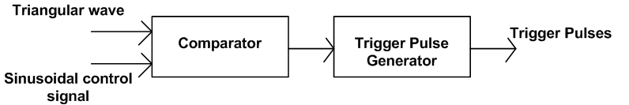
SINE PWM (SPWM)
most commonly used PWM technique
Gating signals are generated by comparing a sinusoidal control signal with a triangular waveform.
Frequency of the sinusoidal control signal is selected as the desired inverter output frequency

Slide 21
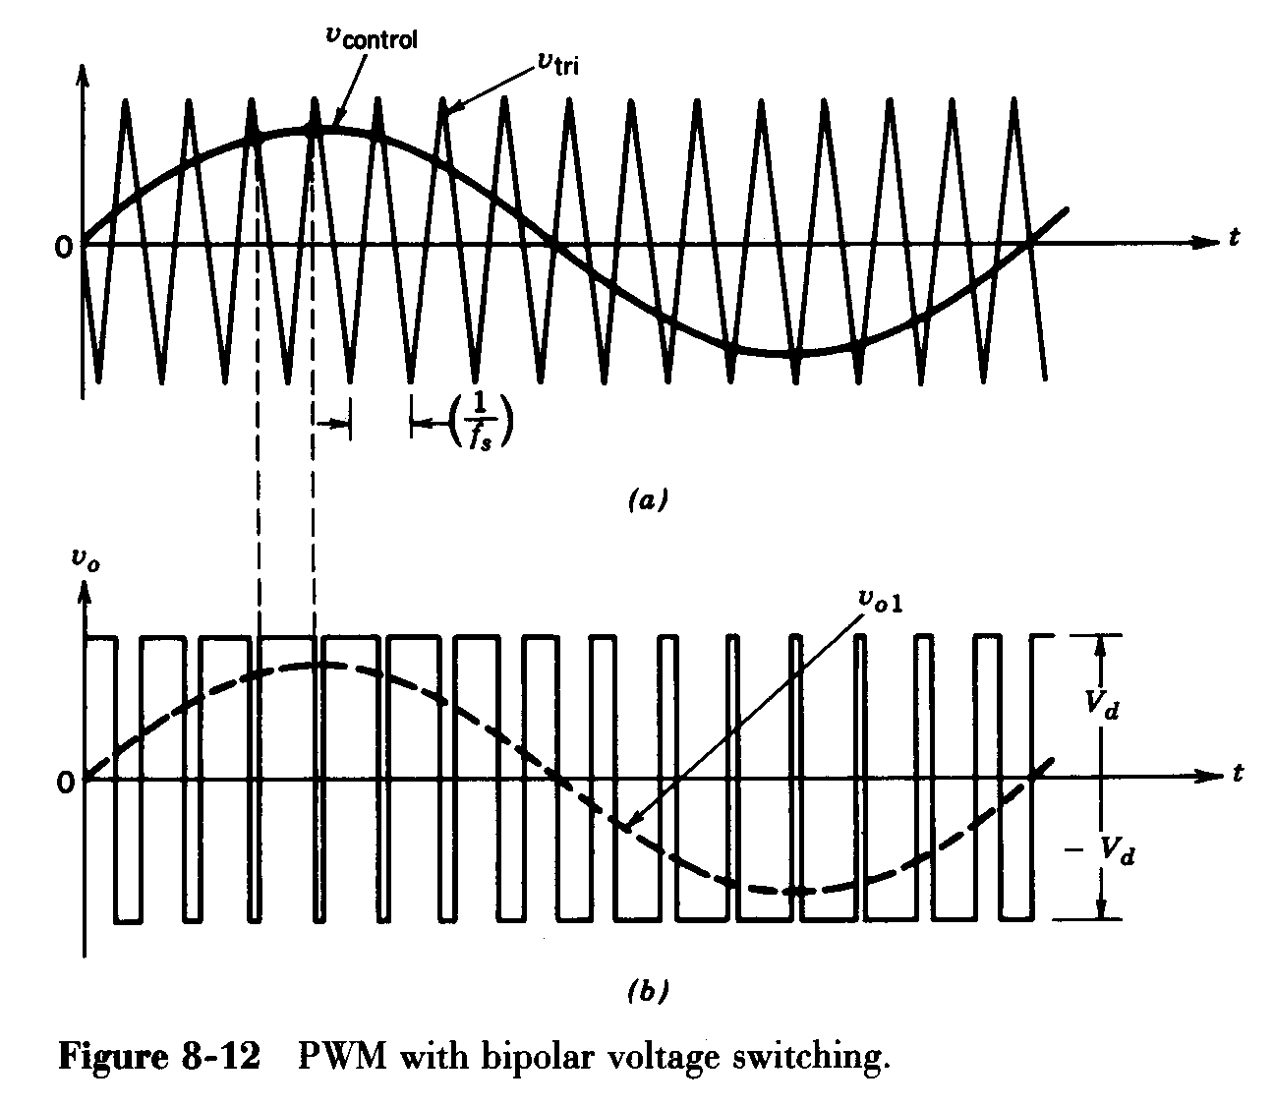
When V_{control} > V_{tri}, T_{A+} and T_{B-} are gated
V₀ = V_{d}
When V_{control} < V_{tri}, T_{B+} and T_{A-} are gated,
V₀ = - V_{d}

Slide 22
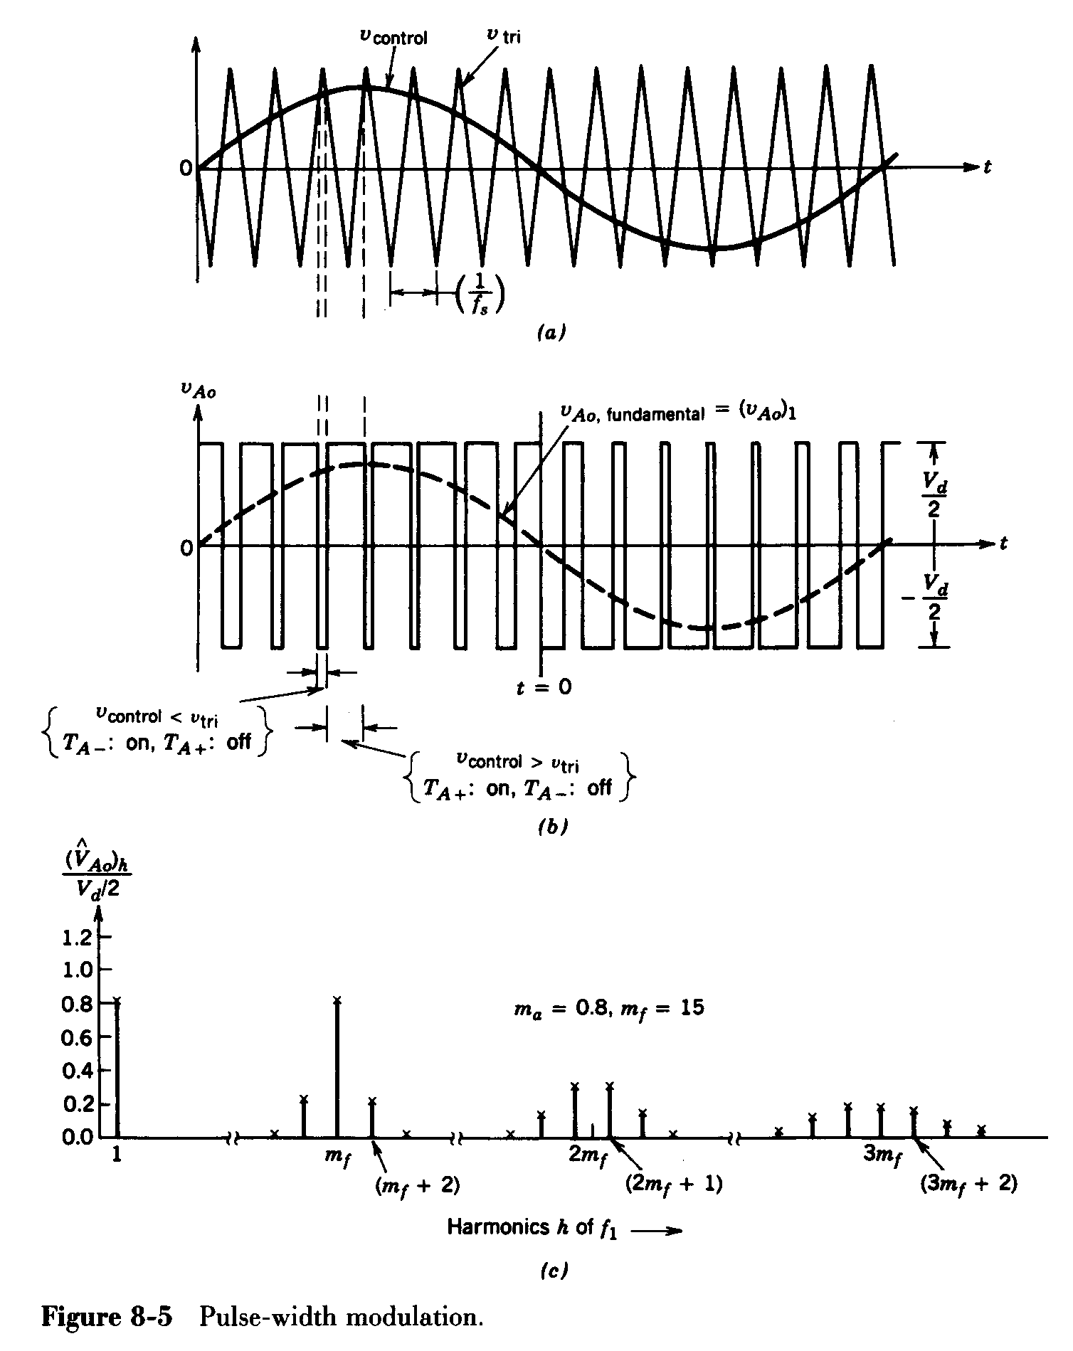
V_{control} < V_{tri},
T_{B+} T_{A-} are on
V₀ = - V_{d}
V_{control} > V_{tri},
T_{A+} T_{B-} are on
V₀ = V_{d}
V₀fundamental V₀₁
V₀
V_{d}
V_{d}
-V_{d}

Slide 24
Triangular wave is called carrier wave.
f_{s} → frequency of the carrier wave
→ switching frequency
→ carrier frequency.
decides the switching frequency of the devices.

Slide 25
V_{control} is the sinusoidal control signal.
Magnitude of V_{control} decides the output magnitude.
f₁ → frequency of the control signal V_{control}
→ desired output frequency
→ modulating frequency.
Frequency modulation ratio m_{f} = f_{s}/f₁

Slide 26
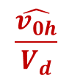
Harmonic Spectrum for SPWM
$$\frac{\hat{v_{0h}}}{V_{d}}$$

Slide 27
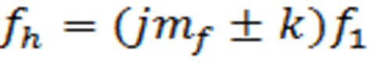
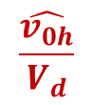
Harmonic Spectrum for SPWM
Even harmonics are not present .
Amplitude of harmonics are independent of m_{f.}
The most dominant harmonic is at and side bands of m_{f} , 2m_{f} etc.
But m_{f} decides the frequency at which harmonics occur.
The frequency at which voltage harmonics occur is indicated as
Harmonics are of the order corresponding to the k^{th} side band of j times the frequency modulation ratio . j=1,2,3….
k is even number for odd values of j and k is odd number for even values of j.
$$\frac{\hat{v_{0h}}}{V_{d}}$$

Slide 28

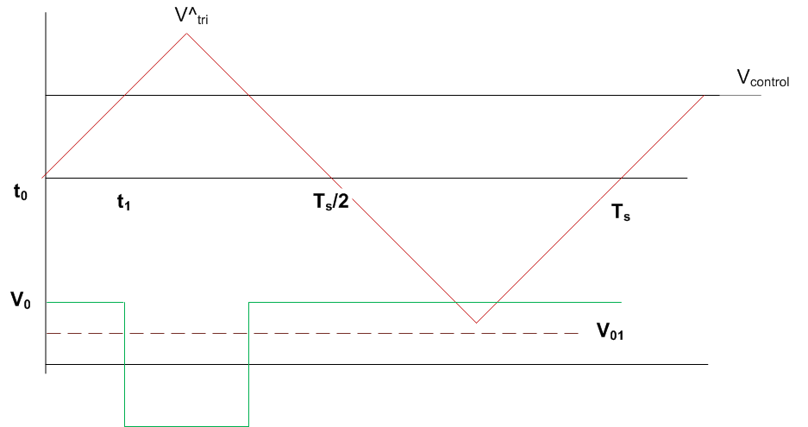
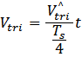
Amplitude of Fundamental Component
switching frequency is
very large compared to the frequency
of control signal
V_{control} is considered as constant in one
switching period
when control signal > carrier signal
Vo = V_{d}
when control signal ˂ carrier signal
Vo = -V_{d}
At t = t₁ , V_{tri} = V_{control}
T_{A+} , T_{B-}
T_{A+} , T_{B-}
T_{B+} , T_{A-}
T_{B+} , T_{A-}

Slide 29

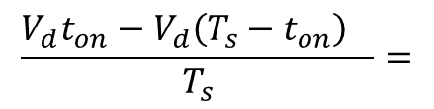
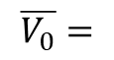
During one switching period, on period of the switch t_{on}= =
average output voltage in one switching period
T_{A+} , T_{B-}
T_{A+} , T_{B-}
T_{B+} , T_{A-}
$$\overline{V_{0}}=$$
$$\frac{V_{d}t_{on}−V_{d}{\left(T_{s}−t_{on}\right)}_{}}{T_{s}}=$$
$$\frac{V_{d}V_{control}}{{\hat{v_{tri}}}_{}}$$

Slide 30
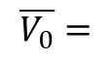

When the control voltage varies sinusoidaly, average output voltages in each switching period also varies sinusoidaly from one switching period to the next.
This is the reason why a sinusoidal signal is chosen as the control signal to provide a sinusoidal output voltage.
$$\overline{V_{0}}=$$
$$\frac{V_{d}V_{control}}{{\hat{v_{tri}}}_{}}$$
v₀₁
VaVdVV

Slide 31
Peak of the fundamental component
Amplitude of fundamental component varies linearly with m_{a} provided m_{a} ≤ 1.
The range of m_{a} is 0 → 1 and is referred to linear range.
m_{f} is selected as an odd integer.
This makes odd symmetry and half wave symmetry resulting in only odd harmonics.

Slide 32
Selection of switching Frequency
If m_{f} is more, order of the dominant harmonics is more. Filter circuit elements required are of low values.
But Switching loss is increased proportionally.
m_{f} = 21 is selected as the border between large and small m_{f}
small m_{f} (m_{f} ≤ 21 )
synchronous PWM is used.
m_{f} is selected as an integer so that triangular wave and control signal are synchronized.
In asynchronous PWM, where m_{f} is not an integer, subharmonics are produced.

Slide 33
Large m_{f} m_{f} ≥ 21 )
When m_{f} ≥ 21 sub harmonics due to asynchronous PWM are small. Hence, asynchronous PWM is permitted.

Slide 34
In linear range of m_{a} (0 to 1)
magnitude of fundamental component depends on m_{a.}
Dominant harmonics are at and the side bands of m_{f} , 2m_{f} etc.

Slide 35
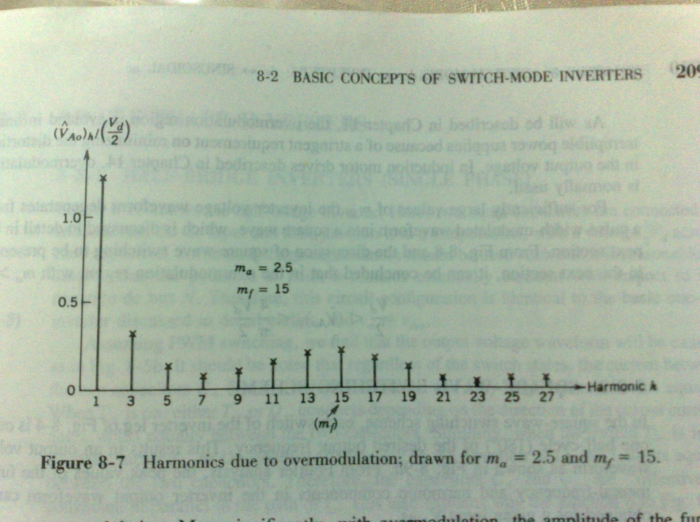
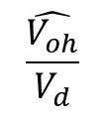
To increase the magnitude of fundamental component, m_{a} is made > 1. This condition is called over modulation.
over modulation
Over modulation m_{a} > 1
Output voltage contains many more harmonics in the side bands of m_{f.}
$$\frac{\hat{V_{oh}}}{V_{d}}$$

Slide 36
Square wave mode
All odd harmonics are present.
Square wave modulation
V_{o}
V_{d}

Slide 37
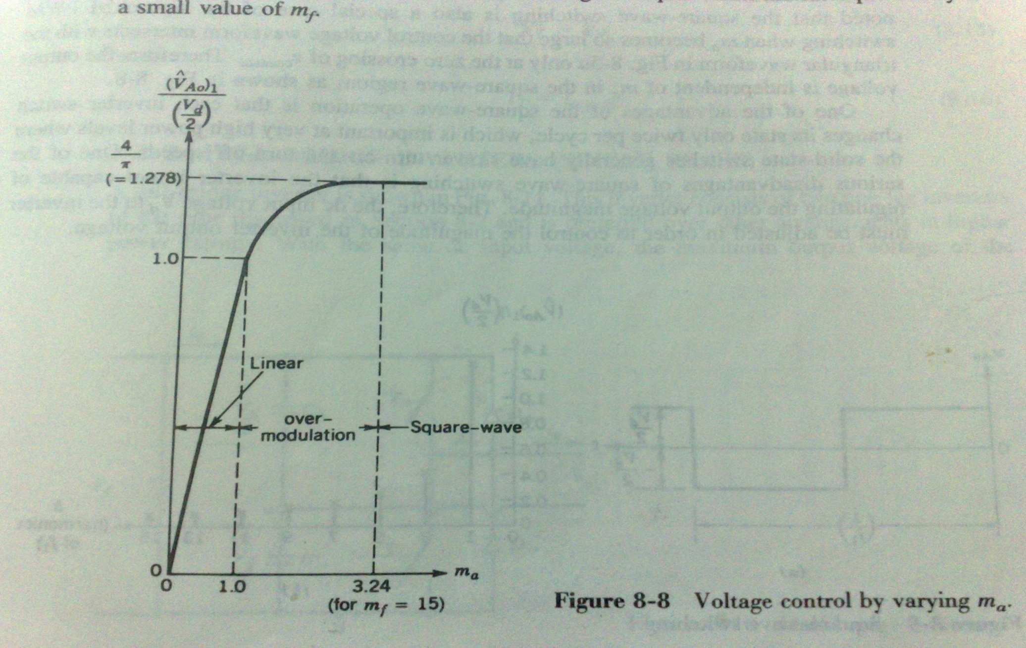
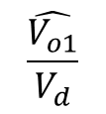
Linear modulation
$$\frac{\hat{V_{o1}}}{V_{d}}$$
over modulation
Square wave modulation

Slide 38
Harmonics which are dominant in the linear range may not be dominant in the over modulation condition.
Amplitude of fundamental component does not vary linearly with m_{a}
In UPS application, over modulation condition must be avoided to minimise distortion.
In induction motor application, over modulation can be used.

Slide 40
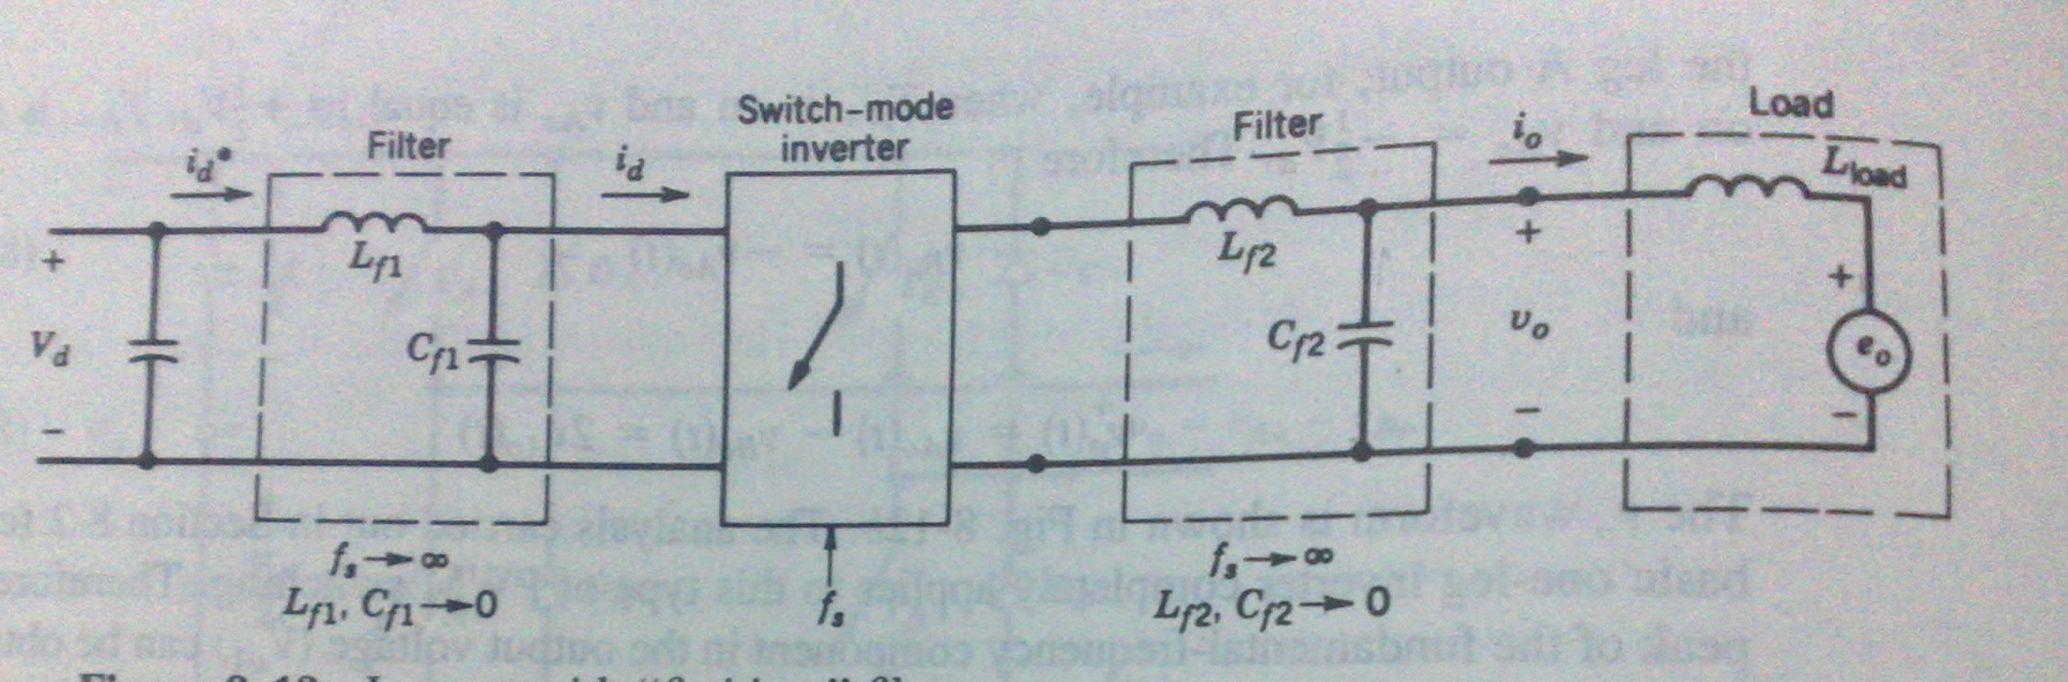
DC Side Current of PWM Inverter
LC filters are used at the dc side and ac side.
Assumptions made while obtaining dc side current.
Infinite switching frequency and hence low harmonic content.
small values of L & C are sufficient to filter out low harmonic content.
Energy stored in the filter elements is negligible.
Converter has no energy storage elements.
Thus, instantaneous input power is equal to the instantaneous output power.
LOAD

Slide 41
Let an inductive load like ac motor is connected to the output.
e₀ is the back emf.

Slide 42
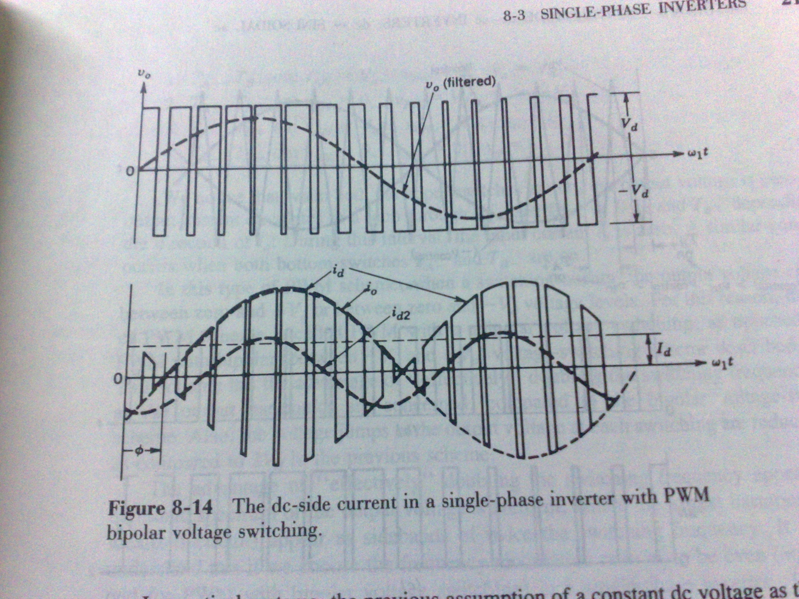
instantaneous input power is = instantaneous output power
= I_{d} + i_{d2}

Slide 44
SPWM with Unipolar Voltage Switching
Legs A is controlled by the control signal V_{control}
Leg B is controlled by the control signal
-V_{control}
When V_{control} > V_{tri}, T_{A+} is on V_{AN} = V_{d}
V_{control} < V_{tri}, T_{A-} is on V_{AN} = 0
T_{B}⁺ on
-v_{control} > v_{tri}
When -V_{control} > V_{tri}, T_{B+} is on V_{BN} = V_{d}
-V_{control} < V_{tri}, T_{B-} is on V_{BN} = 0

Slide 45
When V_{control} > V_{tri}, T_{A+} is on V_{AN} =V_{d}
V_{control} < V_{tri}, T_{A-} is on V_{AN} = 0
When -V_{control} > V_{tri}, T_{B+} is on V_{BN} = V_{d}
-V_{control} < V_{tri}, T_{B-} is on V_{BN} = 0
V₀ = V_{AB} = V_{AN -} V_{BN}

Slide 46
Combination of switch on states
V_{AN}
V_{BN}
V₀
T_{A+} T_{B-}
V_{d}
0
V_{d}
T_{A+} T_{B+}
V_{d}
V_{d}
0
T_{A-} T_{B+}
0
V_{d}
-V_{d}
T_{A-} T_{B-}
0
0
0
Output voltage switches between zero and +V_{d} or zero and –V_{d}
Hence, this scheme is called unipolar voltage switching PWM scheme.

Slide 47
Advantages of unipolar voltage switching PWM scheme.
Number of pulses in V_{o} is twice compared to that in bipolar PWM scheme.
Harmonics appear at the sidebands of 2m_{f}, 4m_{f}, 6m_{f} etc
In each switching, output voltage jump is only V_{d}
compared to 2 V_{d} in bipolar PWM

Slide 48
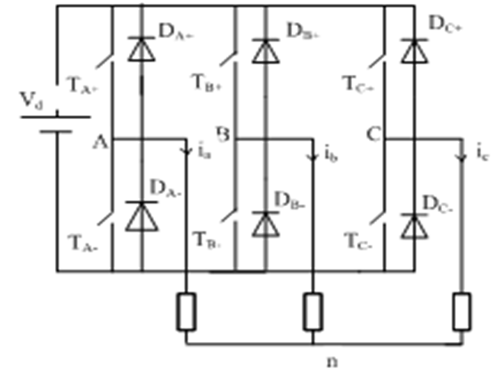
SPWM in Three Phase Inverters
Three control signals
V_{controlA} , V_{controlB} and V_{controlC}
are used for the control of
legs A, B and C respectively.
/
N

Slide 49
SPWM in Three Phase Inverters
/
N
When V_{controlA} > V_{tri}, T_{A+} is on V_{AN} =V_{d}
V_{controlA} < V_{tri}, T_{A-} is on V_{AN} = 0
When V_{controlB} > V_{tri}, T_{B+} is on V_{BN} = V_{d}
V_{controlB} < V_{tri}, T_{B-} is on V_{BN} = 0
When V_{controlC} > V_{tri}, T_{C+} is on V_{CN} = V_{d}
V_{controlC} < V_{tri}, T_{C-} is on V_{CN} = 0
V_{AB} = V_{AN} - V_{BN}
V_{BC} = V_{BN} – V_{CN}
V_{CA} = V_{CN} - V_{AN}

Slide 50
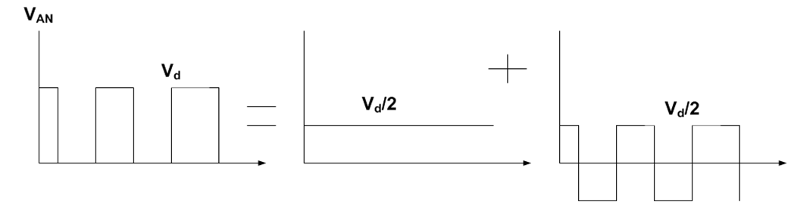
V_{AN} and V_{BN} consist of a constant voltage V_{d} /2 and a bipolar voltage of magnitude V_{d}/2
Most dominant harmonic in V_{AN} and V_{BN} are of the order of m_{f}
Phase difference between m_{f}^{th} harmonic in V_{AN} and m_{f}^{th} harmonic V_{BN} is (120*m_{f}).
In line to line voltage V_{AB} harmonics at m_{f} and odd multiples of 3 are suppressed
This is zero if m_{f} is an odd multiple of 3.

Slide 52
For linear range of m_{a}, Peak value of fundamental component in V_{AN}
RMS value of fundamental component in V_{AN}
RMS value of line to line voltage of fundamental component
Maximum possible RMS value of fundamental component in linear range occurs when m_{a} is 1.

Slide 53
Square Wave Mode of 3phase inverter
Peak value of fundamental component in V_{AN}
RMS value of line to line voltage of fundamental component
Amplitude of n^{th} harmonics

Slide 55
DC Side Current of 3Ф PWM Inverter
Assumptions
Infinite switching frequency and hence low harmonic content.
small values of L & C are sufficient to filter out low harmonic content
Energy stored in the filter is negligible.
Converter has no energy storage elements.
Thus, instantaneous input power is equal to the
instantaneous output power.

Slide 58
Effect of Blanking time on output voltage in PWM inverters
T_{A}⁺ is turned on instantaneously when v_{control} > V_{tri}
T_{A}⁻ is turned on instantaneously when v_{control} < V_{tri}
To avoid short circuiting of the dc source, turn on of the incoming switches are delayed by a period of t∆ called blanking period

Slide 59
V_{control}
t_{Δ}
t_{Δ}
i_{gA+} i_{gB-}
No blank period
i_{gB+} i_{gA-}
V_{d}
V_{AN} With no blank period
i_{gA+} i_{gB-}
With blank period
D_{A+} D_{B-}
i_{gB+} i_{gA-}
V_{AN} With blank period and i_{o} ˂ 0
V_{AN} With blank period and i_{o} ˃ 0
D_{A-} D_{B+}

Slide 60
V_{control}
During blanking interval both the switches are off and V_{AN} depends on the direction of current
For Leg A
Average drop in output voltage due to blanking period in one switching interval
t_{Δ}
t_{Δ}
i_{gA+} i_{gB-}
No blank period
i_{gB+} i_{gA-}
V_{AN} With no
blank period
i_{gA+} i_{gB-}
D_{A+} D_{B-}
i_{gB+} i_{gA-}
V_{AN} With blank period and i_{o} ˂ 0
V_{AN} With blank period and i_{o} ˃ 0
D_{A-} D_{B+}

Slide 61
During blanking interval both the switches are off and V_{AN} depends on the direction of current
For Leg A
Average drop in output voltage due to blanking period in one switching interval
∆V_{AN} is independent of the magnitude of i_{A} but depends on the direction of i_{A}
∆V_{AN} is proportional to blanking period and switching frequency

Slide 62
For leg B
V₀ = V_{AN} - V_{BN} , i₀ = i_{A}
Average drop in output voltage during T_{s} is

Slide 63
Average drop in output voltage during T_{s} is
Variation of average output voltage during one T_{s} with variation in v_{control}

Slide 64
For sinusoidal V_{control}, instantaneous average load voltage is as given below.
The distortion results in lower order harmonics such as 3rd, 5th, 7th etc.

Slide 65
Third Harmonic Injection PWM
The modulating wave v_{mA} is composed
of a sinusoidal component v_{m1} at the required output frequency and a third harmonic component v_{m3.}
This reduces the peak of the modulating wave and hence avoids the over modulation condition.
This modulation technique is known as third harmonic injection

Slide 66
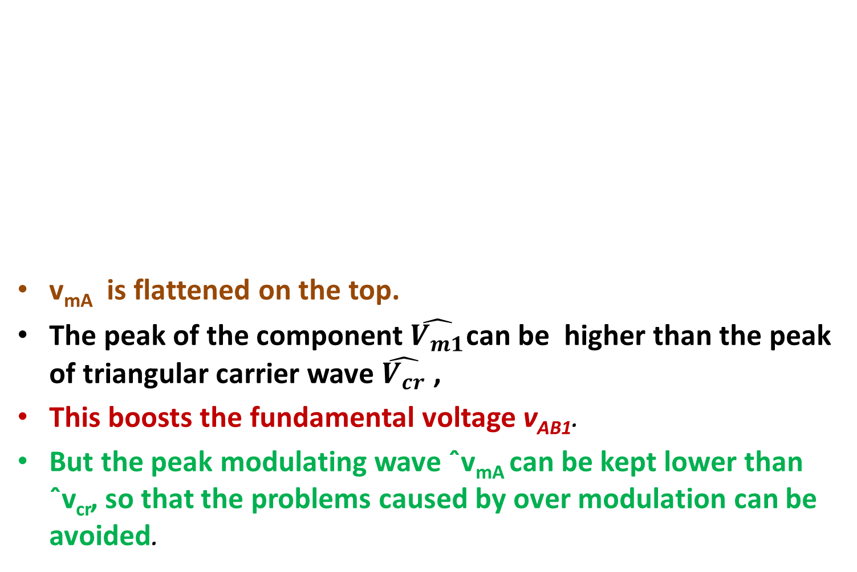
v_{mA} is flattened on the top.
The peak of the component $\hat{V_{m1}}$can be higher than the peak of triangular carrier wave $\hat{V_{cr}}$,
This boosts the fundamental voltage v_{AB1}.
But the peak modulating wave ˆv_{mA} can be kept lower than ˆv_{cr}, so that the problems caused by over modulation can be avoided.

Slide 67
The maximum amount of v_{AB1} that can be increased by this scheme is 15.5%.
The injected third harmonic component vm3 will not increase the harmonic distortion for vAB.
It appears in each of the inverter terminal voltages vAN, vBN and vCN
It does not exist in the line-to-line voltage v_{AB}.
v_{AB} = v_{AN} – v_{BN},
The third-order harmonics in vAN and vBN cancel each other.

Slide 68
C- Filter to Eliminate Output Harmonics
A single phase full bridge inverter supplies a load of R = 10Ω, L = 31.5mH and C = 112μF. The dc input voltage is V_{s} = 220V and the inverter frequency is f₀ = 60Hz.The output voltage has two notches such that the third and fifth harmonics are eliminated.
Determine the expression for the load current.
If an output C filter is used to eliminate seventh and higher order harmonics, determine the filter capacitance.

Slide 69
Inductive reactance for the nth harmonic voltage is
X_{L} = j2n× π × 50×31.5×10⁻³
= j9.9nΩ

